Slide 1

BUSINESS REPORT
——Data Challenge
Chuwen Feng
11/16/2022

Slide 2

CONTENTS
BACKGROUND
DATA OVERVIEW
DATA QUALITY CHECKS
&
CLEANSING
ANALYSIS
RECOMMENDATION
FUTURE KPI
&
WHAT’S NEXT

Slide 3
BACKGROUND
An airline company looking to enter the United States domestic market and decided to start with 5 round-trip routes between medium and large US airports.

Slide 4





Clarifying Questions
BACKGROUND
The 10 busiest round trip routes
You are consulting for an airline company looking to enter the United States domestic market which has identified medium and large airports as their desired operating locations. The company believes that it has a competitive advantage in maintaining punctuality, so it plans on making this a big part of its brand image with a motto, “On time, for you” To kick start operations, the company has decided to start with 5 round trip routes.
The 10 most profitable round trip routes
Investment recommendation for 5 round trip routes
Definition Clarify
Round Trip:
We define a round trip as a combination of 2 routes (from and to), between two airports (E.g. The combination of Route A to B and Route B to A is a Round Trip Route , The opposite order of the route: Route B to A and Route A to B would be the same round trip. )
The number of round trip flights breakeven
Future KPI Recommendations

Slide 5

Factors to Consider When Entering a New Market
Revenue
Financial Feasibility
Cost
Internal
Customer Service
Management Capability
Feasibility of Entry
Competitors Name
Competition Situation
External
Competitors Number
Customer segmentation
Market Attractiveness
Policy and Regulation

Slide 6
Financial Factors
Profit
Revenue
Cost
Other Revenues
Ticket Fee
Variable Cost
Fixed Cost
Baggage Fee
Fuel, Oil, Maintenance, Crew
Airplane Cost
Depreciation, Insurance, Other
Airport Operation Cost
Delay Cost
Docking Cost

Slide 7
DATA OVERVIEW
Overview of the Initial Datasets

Slide 8
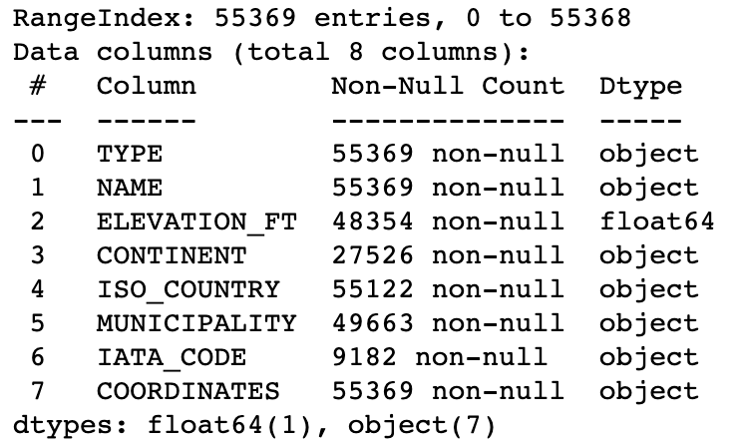
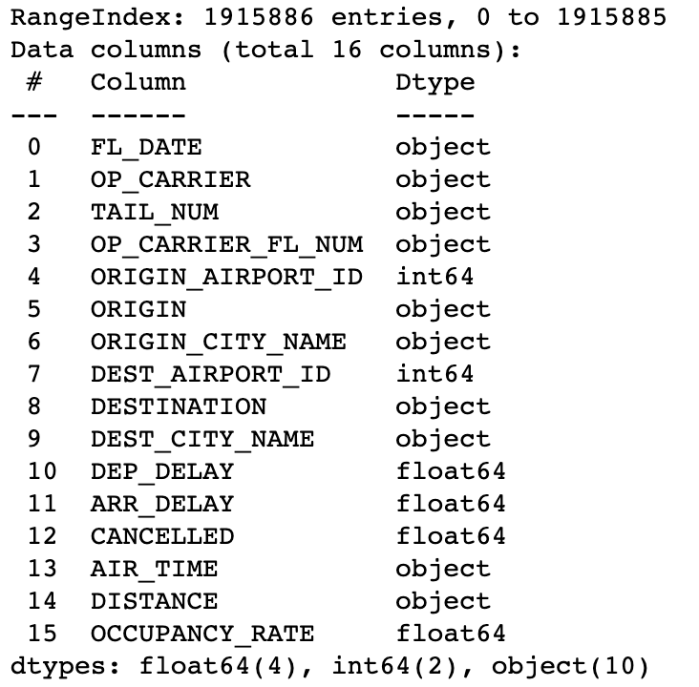
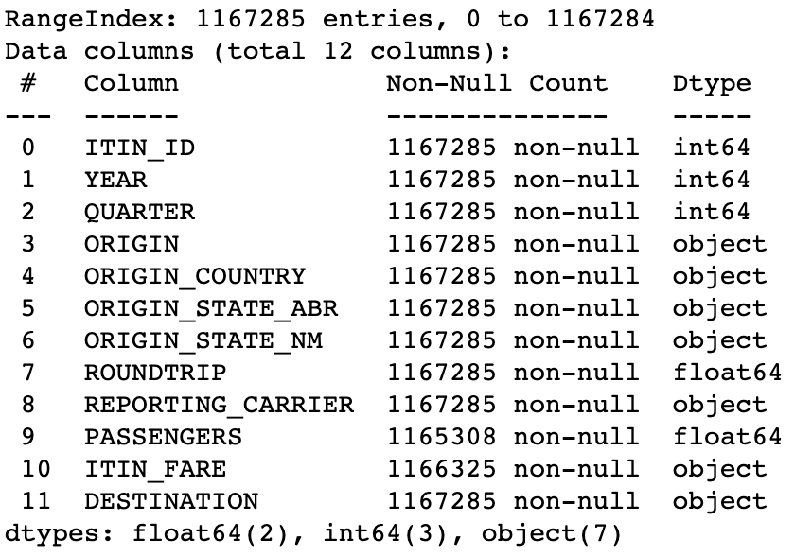
Datasets Overview
Airport codes Dataset
Flights Dataset
Tickets Dataset

Slide 9
DATA QUALITY CHECK&
CLEANSING
Data cleaning is the process of fixing or removing incorrect, corrupted, incorrectly formatted, duplicate, or incomplete data within a dataset.

Slide 10
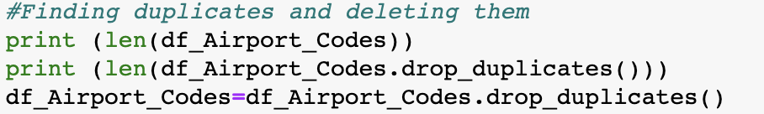
Data Quality Checks & Cleansing
Check for Duplicates
From this, we found out duplicates in the these three files.
2. Subset the Data Frame
Subset df_Airport_Codes data frame to include only data about the medium and large airports in the US. Subset df_Flights data frame to include only data about not canceled flights. Subset df_Tickets data frame to include only data about round-trip flights.
Files | Duplicates
Df_Airport_Codes | 101
df_Flights | 4545
Df_Tickets | 71898
Files | Before subset | After subset
Df_Airport_Codes | 55268 | 858
df_Flights | 1911341 | 1859862
Df_Tickets | 1095387 | 661036

Slide 11
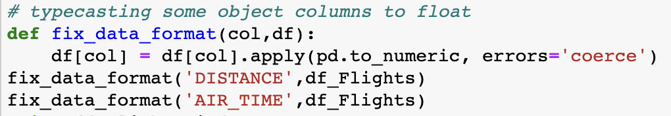
Data Quality Checks & Cleansing
3. Removing Unnecessary Columns to have a good analysis
To have the best analysis we need to keep only the important pieces and discard other pieces of information.
4. Typecasting Some Object Columns to Float
In the df_Flights dataset, typecasting the columns ”DISTANCE” and ”AIR_TIME” from the object into float.
5. Handle null value
Since the percentage of missing values is small, so I’d like to drop them.
Files | Columns Removed
Airport_Codes | 'NAME','CONTINENT','ISO_COUNTRY','MUNICIPALITY','COORDINATES','ELEVATION_FT'
Flights | 'OP_CARRIER','FL_DATE','OP_CARRIER_FL_NUM','CANCELLED','ORIGIN_AIRPORT_ID','DEST_AIRPORT_ID'
Tickets | 'ITIN_ID’, 'YEAR’, 'QUARTER’, 'ORIGIN_COUNTRY’, 'ORIGIN_STATE_ABR’, 'ROUNDTRIP’,’REPORTING_CARRIER’
Files | Percentage of Null Value
Df_Airport_Codes | 4%
df_Flights | 0.5%
Df_Tickets | 0.4%

Slide 12
Assumptions
PASSENGERS
TYPE
Airplane
If you find yourself uncertain of what the “right” answer is, use your best judgment, make an assumption, document the rationale, and keep going.
The number of round trip passengers should between 0 and 300.
We only consider medium and large airports.
Each airplane is dedicated to one round trip route between the 2 airports
AIR_TIME
OCCUPANCY_RATE
DISTANCE
The flight time is an integer between 30 and 600 minutes.
Occupancy of flight rate is a floating number is between 0 and 1.
The distance between airports is a floating number between 310 and 5100 miles.

Slide 13
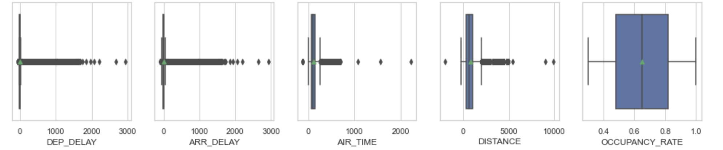
Data Quality Checks & Cleansing
6. Handle Outliers
After the barplot for the numeric variables of df_Flights dataset, It shows that the minimum airtime is too short and the maximum airtime is too long which are both unreasonable; the minimum distance is too short, and the maximum distance is too long which are both unreasonable
After research, I realized the shortest flight was a 30-minute nonstop flight from Los Angeles to San Francisco, with a distance of 310 miles, and the longest flight was from Boston to Honolulu, with a distance of 5,100 miles. So we drop observations out of these ranges.
For the arrival time, I'd believe that (-94,2923)is a normal range, which same as the departure time's range(-64,2941), so I keep the original data.

Slide 14
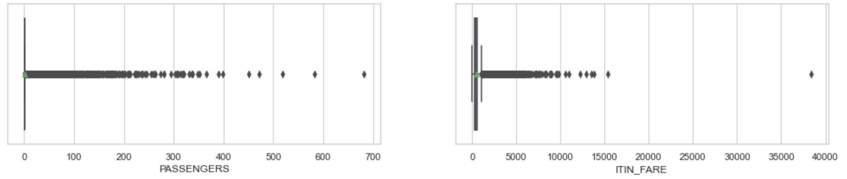
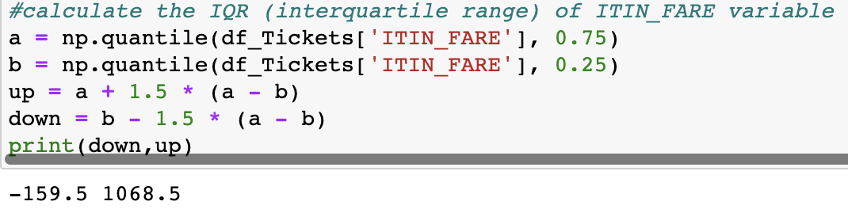
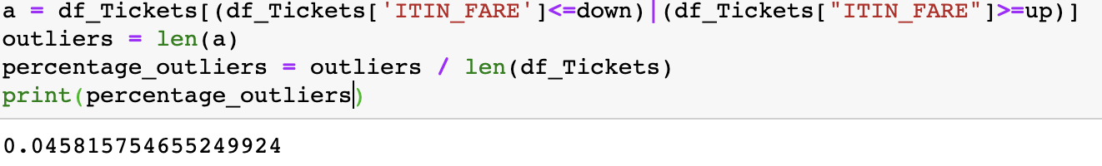
Data Quality Checks & Cleansing
After the barplot for the numeric variables of df_Tickets dataset, it told that the ideal capacity is 200, so we could see the passengers over 300 is outliers. The maximum ITIN_FARE is too high which is unreasonable, I’d like to calculate the IQR(interquartile range) of the fare.
It shows that the percentage of the outliers is only 4%, so I prefer to drop them.

Slide 15
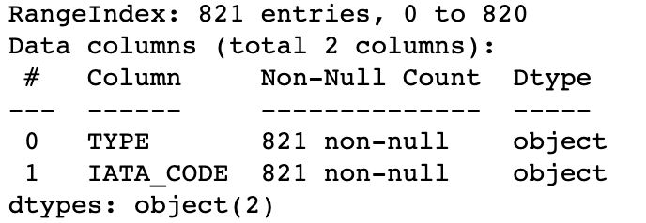
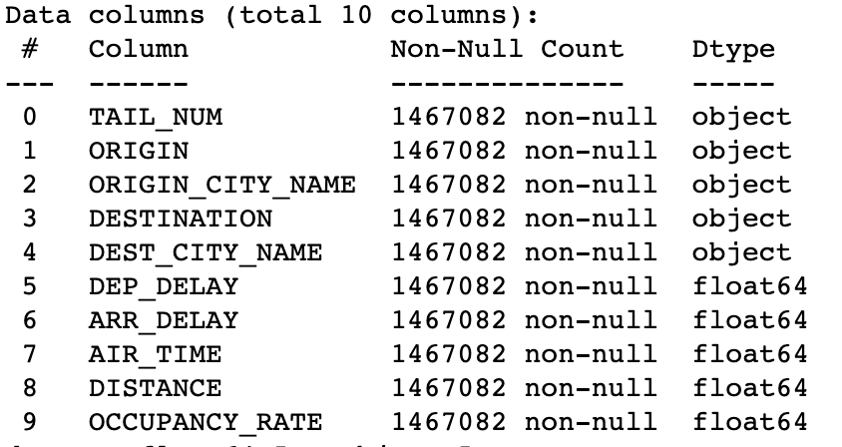
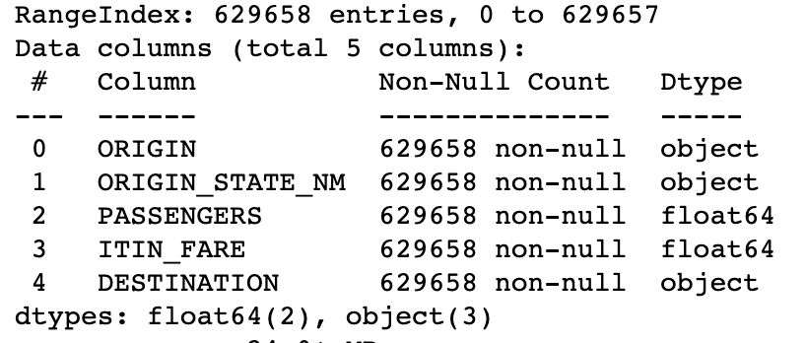
Before & After
Df_Airport_Codes dataset
Df_Flights dataset
Df_Tickets dataset

Slide 16
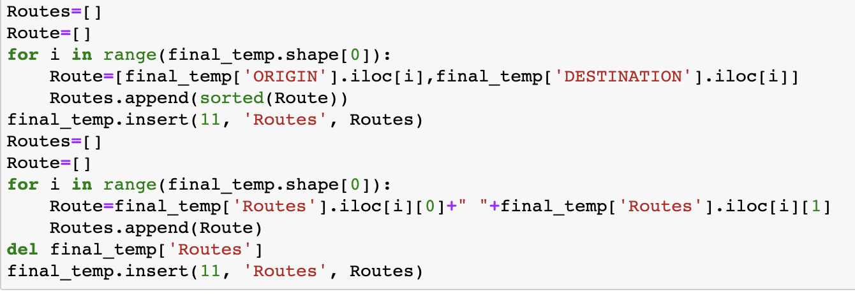
Data Transformations & Merge
7. we reset the indices, reset the indices from 0 avoiding the indices to be out of order.
8. Data Transformations & Join
df_Airline_Codes
df_Flights.
Appended ‘ORIGIN’ and ‘DESTINATION’ into new column “Routes”
final_temp
Aggregate
Concat by “Routes”
final_temp
Attach docking fee, delay fee, delay number
Calculate the number of round-trip routes into a new column “ROUNDS”
final
Appended ‘ORIGIN’ and ‘DESTINATION’ into new column “Routes”
df_Tickets
df_Tickets
Aggregate

Slide 17
Data Transformations & Join
Final dataset
columns | Datatype | Description
Routes | string | [ORIGIN DESTINATION]
OCCUPANCY RATE | float | Average occupancy rate of the flight
DISTANCE | float | Average distance between origin and destination airports in miles
DELAY_DEP_COST | float | Sum of delay departure cost of the airplane.
DELAY_ARR_COST | float | Sum of delay departure cost of the airplane.
DOCKING_COST_ORIGIN | float | Average docking cost in the origin airport.
DOCKING_COST_DES | float | Average docking cost in the origin airport.
DELAY_DEP_COUNT | float | The number of delayed departures.
DELAY_ARR_COUNT | float | The number of delayed arrivals.
ITIN_FARE | float | Sum of Itinerary Fare.
PASSENGERS | float | Sum of the number of passengers on the itinerary.
ITIN_FARE_PER_PASSENGER | float | Itinerary fare per passenger on the itinerary.
OCCUPANCY | float | Average passengers on each flight (based on 200 passengers each flight )
ROUNDS | float | The number of each round trip routes.

Slide 18
ANALYSIS
Analysis our final dataset “final”

Slide 19
Factors That Affect the Investment of Airlines
Our Major Goal is
Increase Customer Base
Increase Profit
Make sure a high ROI(Return On Investment)
Make sure that there is a minimum delay as our motto is "On time, for you”

Slide 20
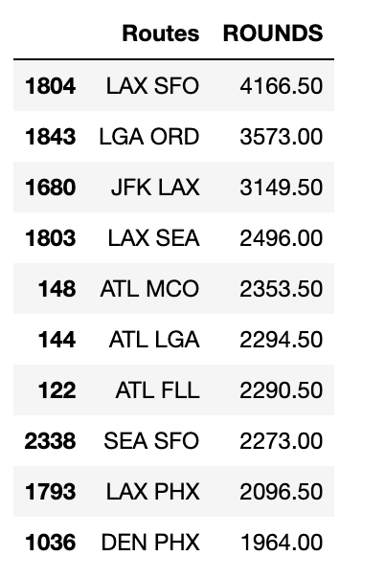
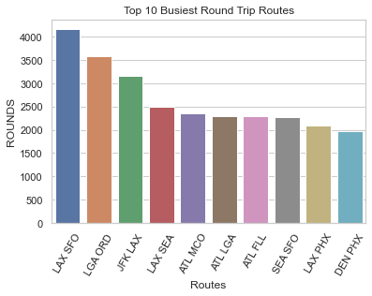
The 10 Busiest Round Trip Routes
We could find this out by sorting the data with respect to rounds (number of each routes).
The top 10 Busiest round trips would be
1. Los Angeles, CA San Francisco, CA
2. New York, NY Chicago, IL
3. New York, NY Los Angeles, CA
4. Los Angeles, CA Seattle, WA
5. Atlanta, GA Orlando, FL
6. Atlanta, GA New York, NY
7. Atlanta, GA Fort Lauderdale, FL
8. Seattle, WA Francisco, CA
9. Los Angeles Phoenix, AZ
10. Denver, CO Phoenix, AZ

Slide 21
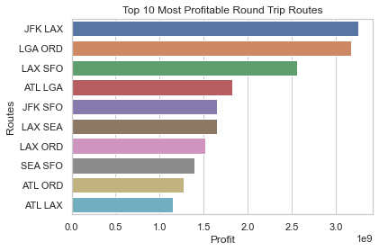
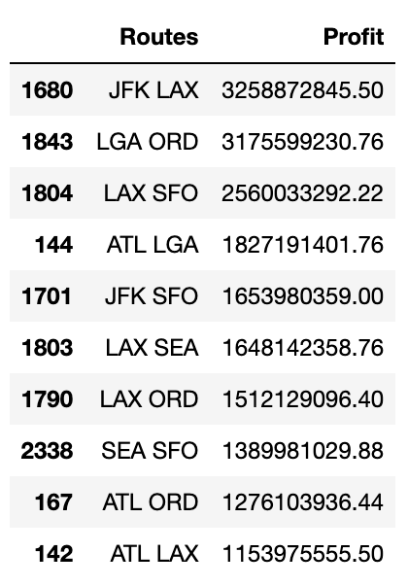
The 10 Most Profitable Round Trip Routes
Calculating the Profit
Itinerary fare represents the whole round trip fare if ROUNDTRIP = 1.
Revenue = PASSENGERS * (Baggage_Fee + ITIN_FARE_AVG) * Rounds
Cost = (Maintenance_Fee + Depreciation_Fee) * (2 * DISTANCE * Rounds) + Delay_Fee + Docking Fee
Profit = Revenue - Cost (without considering the upfront airplane cost)
The Top 10 Profitable Round Trips would be
1. New York, NY Los Angeles, CA
2. New York, NY Chicago, IL
3. Los Angeles, CA San Francisco, CA
4. Atlanta, GA New York, NY
5. New York, NY San Francisco, CA
6. Los Angeles, CA Seattle, WA
7. Los Angeles, CA Chicago, IL
8. Seattle, WA San Francisco, CA
9. Atlanta, GA Chicago, IL
10. Atlanta, GA Los Angeles, CA

Slide 22
RECOMMENDATION

Slide 23
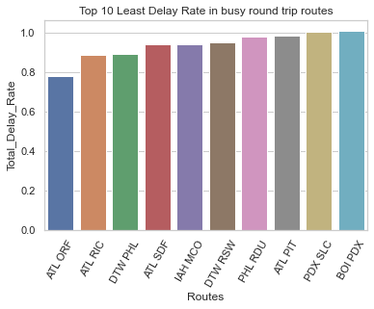
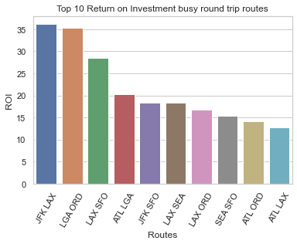
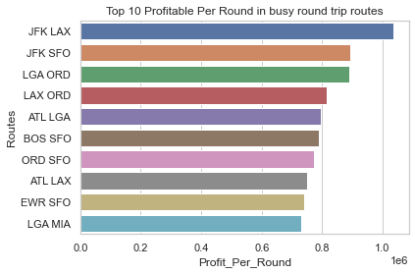
Factors That Affect the Investment of Airlines
Top 10 Least Delay Rate in busy round trip routes
Top 10 Return on Investment in busy round trip routes
Top 10 Profitable per Round in busy round trip routes
Atlanta, GA Norfolk, VA
Atlanta, GA Richmond, VA
Detroit, MI Philadelphia, PA
Atlanta, GA Louisville, KY
Houston, TX Orlando, FL
New York, NY Los Angeles, CA
New York, NY Chicago, IL
Los Angeles, CA San Francisco, CA
Atlanta, GA New York, NY
New York, NY San Francisco, CA
New York, NY Los Angeles, CA
New York, NY San Francisco, CA
New York, NY Chicago, IL
Los Angeles, CA Chicago, IL
Atlanta, GA New York, NY

Slide 24
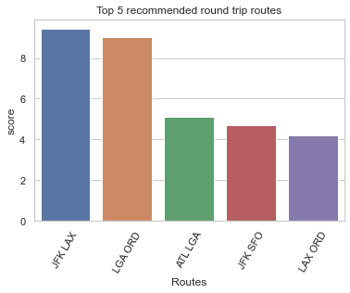
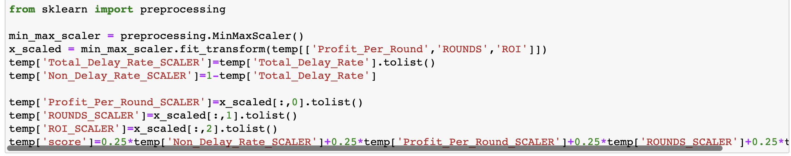
Top 5 Recommended Round Trip Routes
Building Score metric
First, we will be normalizing Profit, Rounds, and Delay Rate between 0,1 and these will be our scores individually. For profit, ROI, and Rounds increasing scores mean good scores, but for Delay Rate it would be the inverse. So after normalizing we would negate it by 1 Then define our score metric. It would be our weighted average. We will have 25% weightage on delay rate, 25% on Rounds, 25% on ROI, and 25% on profit per round.
My top 5 choice would be
1. New York, NY Los Angeles, CA
2. New York, NY Chicago, IL
3. Atlanta, GA New York, NY
4. New York, NY San Francisco, CA
5. Los Angeles, CA Chicago, IL

Slide 25
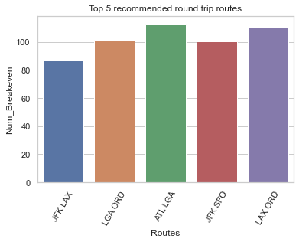
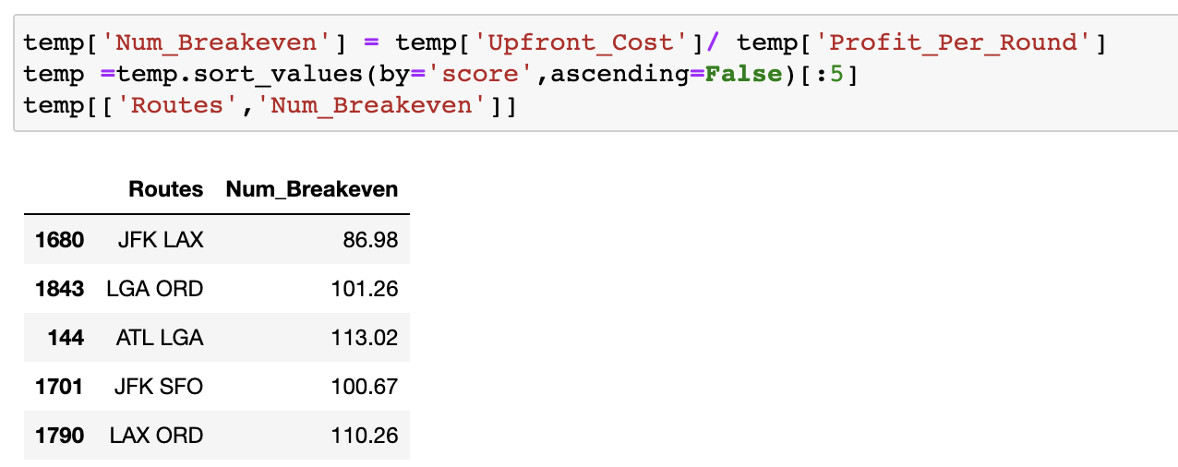
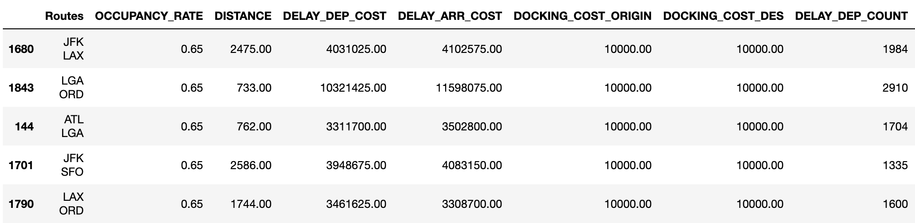
The Number of Round-trip Flights to breakeven
1. New York, NY Los Angeles, CA
2. New York, NY Chicago, IL
3. Atlanta, GA New York, NY
4. New York, NY San Francisco, CA
5. Los Angeles, CA Chicago, IL

Slide 26
FUTURE KPI & WHAT’S NEXT

Slide 27
Key Performance Indicators (KPI’s) that recommend tracking in the future
01
ROI By Region
Based on the factors when we consider entering the new market, Local Customer Habits is an important aspect to measure the local markets situation. Analyzing round trip flights by region will provide better insight into each region and enable analysis of solutions with local realities.
02
Delay Rate
The company believes that it has a competitive advantage in maintaining punctuality, so the most effective way to improve its reputation is to maintain a competitive advantage and strictly monitor flight delays.
03
Occupancy Rate
Occupancy rate is a key measurement of whether an aircraft can make a profit. When the occupancy rate drops, the fixed cost of an airline‘s operation remains, which may lead to a huge loss.

Slide 28
What’s Next
Gathering more business-related information to have more precise measurements For example,
01
More Flights Information: At least one year dataset instead of one quarter; the more information we got the more precise we could measure.
02
Competition Situation: The number of competitors, competitors’ size, resources, products, promotions, brand reputation, historical performance, market champaign, market share.
03
Customer Segmentation: Based on customer’s purpose of travel segment them into different group and provide them specific promotions and level seats.
04
Market Attractiveness: Market share information, market scale, and market growth rate.
05
Policy and Regulation: Is there any policy and regulation to be carried out by the government to support tourism or the aviation industry.
06
Customer Service: The company’s reputation can be measured by asking consumers about the quality of its customer service through questionnaires. The company’s reputation will further affect the user base.
07
Distribution of Business and Economy level seats: It can provide us with more precise information about the itinerary fare distribution.

Slide 29
THE END，THANKS

